Slide 1
Cellular Vision
Enhancing Medical Insights through Image Analysis
Presented by Kyrollos , Norhan, and Mohamed

Slide 2
Goal
Advance cell detection through the implementation of robust computer vision algorithms.
Develop methods that excel in accurately identifying and analyzing cells within images.
Enhance precision, speed, and effectiveness in cell detection for medical diagnostics and research.
Contribute to advancements in various fields reliant on accurate cellular analysis.

Slide 3
Motivation
Address limitations in traditional cell detection methods regarding scalability, accuracy, and computational efficiency.
Innovate and explore novel techniques to revolutionize circle detection methodologies.
Bridge the gap between traditional approaches and cutting-edge technology in cellular analysis.
Empower researchers, clinicians, and industries reliant on cell analysis with precise and advanced tools for investigations and applications.

Slide 4
Objectives
Utilizing Circle Detection By Traditional Methods
Dataset Refinement for Our Machine Learning Model
Pushing Boundaries with YOLO for Circle Detection
Unveiling Special Properties Post-Detection

Slide 5
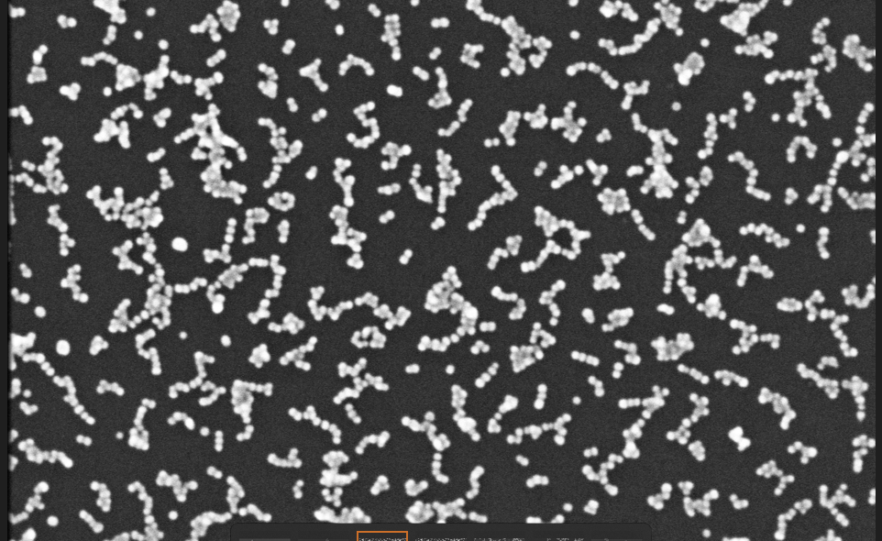
Traditional Method of Circle Detection
Goal and Motivation
Innovate cell detection in medical imaging.
Overcome dataset limitations for accurate and scalable cell detection.

Slide 6
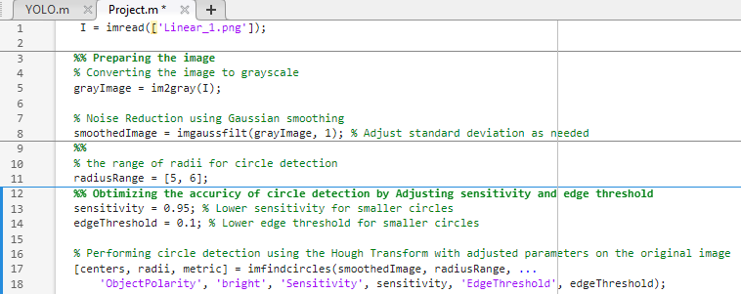
Methodology
Objective: Cell detection via image processing techniques.
Preparing the Image:
Grayscale Conversion: 'im2gray' function for further processing.
Gaussian Smoothing: 'imgaussfilt' applied to reduce image noise.
Adjusting Paramters
Radius Range: Defined as [5, 6]
Sensitivity & Edge Threshold: Adjustments made for better detection.
Hough Transform: Utilized via 'imfindcircles' for circle detection.

Slide 7
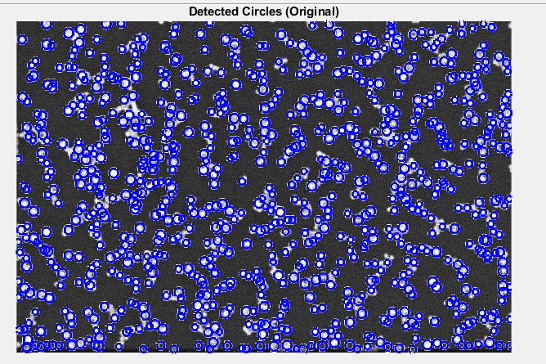
Results

Slide 8
Limitation

Slide 9
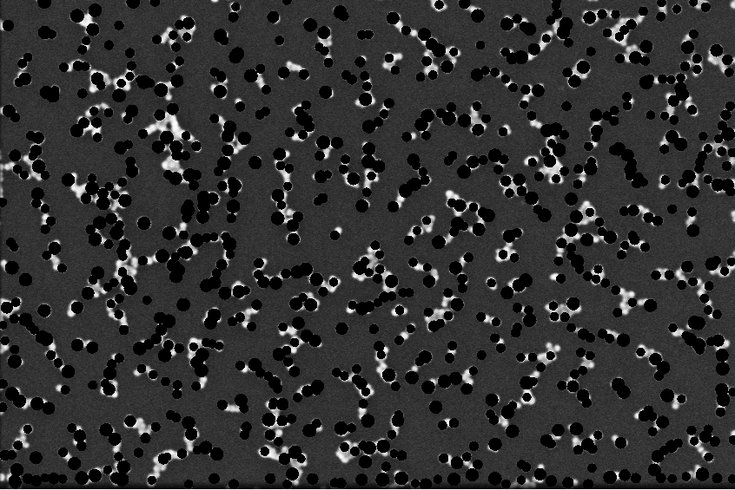
Limitation

Slide 10
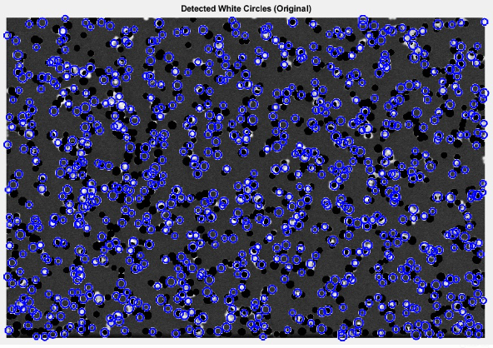

Slide 11
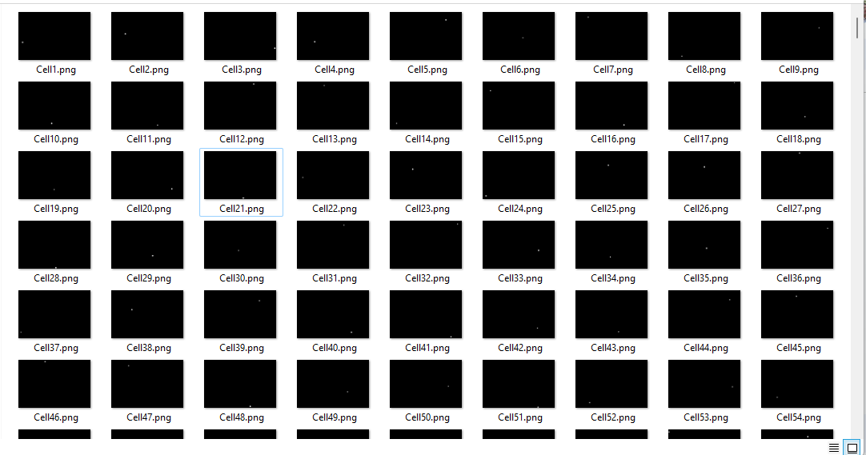
Results (Preparing Our Dataset)

Slide 12
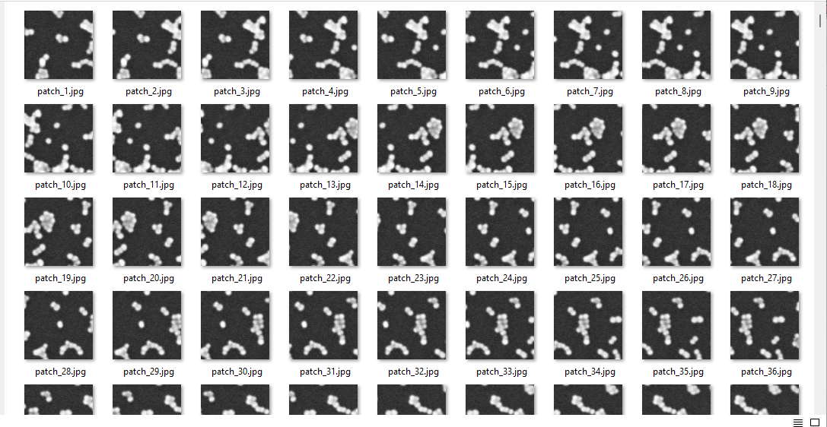
Results (Preparing Our Dataset)

Slide 13
What is Yolo
YOLO, which stands for "You Only Look Once," is a family of object detection algorithms in computer vision. The YOLO algorithm is designed to detect and locate objects within an image in real-time. The key characteristic of YOLO is its ability to perform both object detection and classification simultaneously.

Slide 14
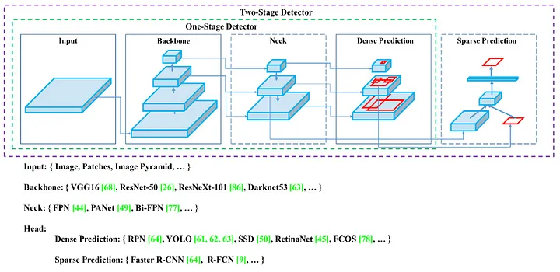
Architecture

Slide 15
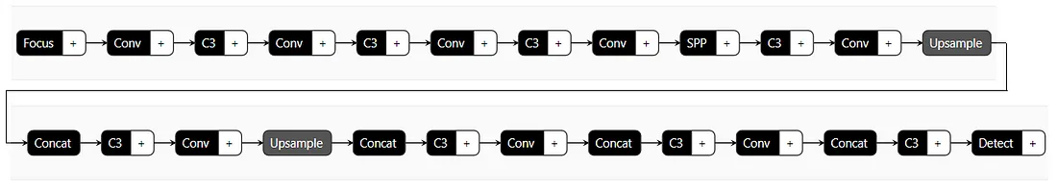
Architecture

Slide 16
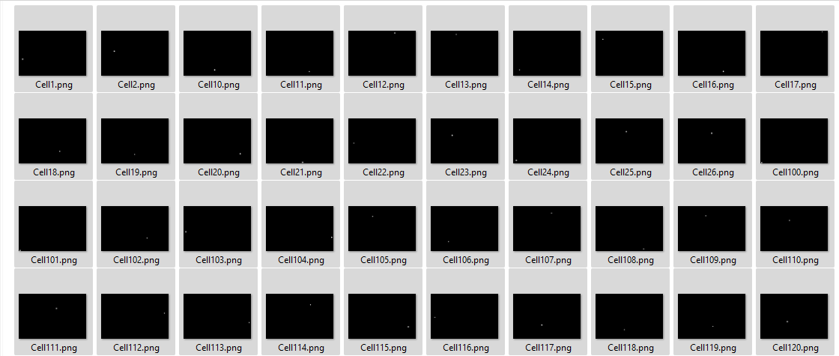
Methods: Data Augmentation

Slide 17
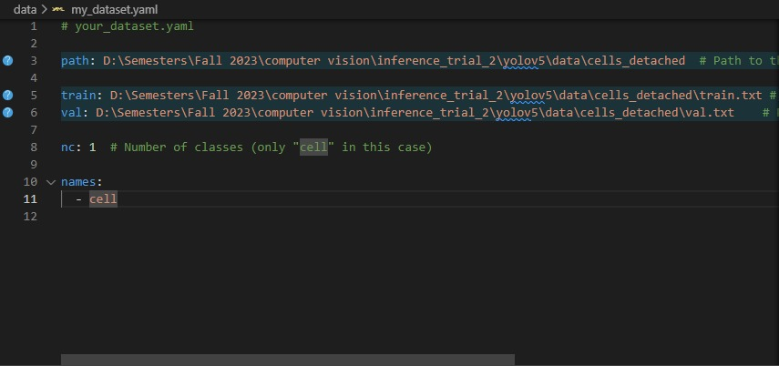
Methods: Creating Dataset configuration

Slide 18
Methods: Creating Dataset configuration

Slide 19
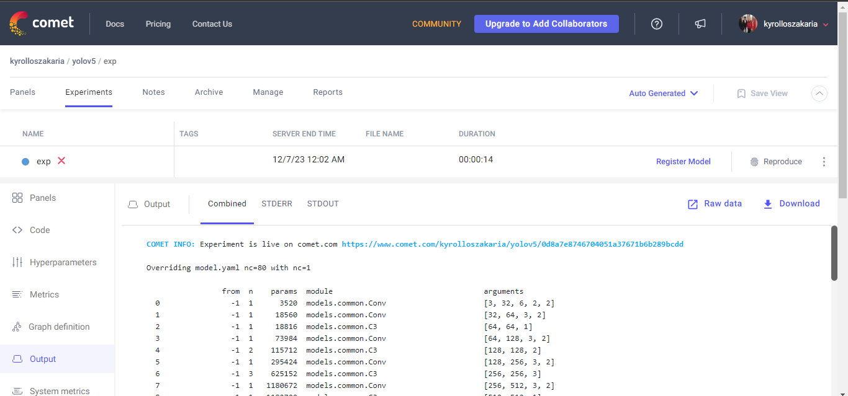
Methods: Setting Comet for interpretability

Slide 20
Extracting Properties From Cells
Size of each cell.
Location of each cell.
Distance of a random cell to other cells.

Slide 21
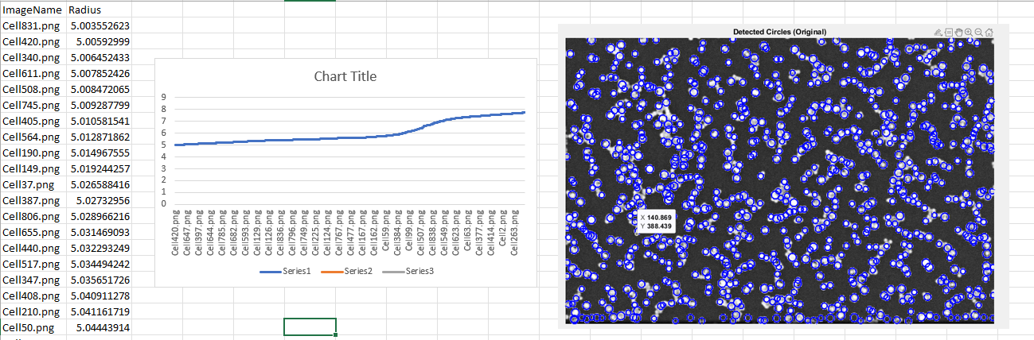
Cell Radii - All Sizes

Slide 22
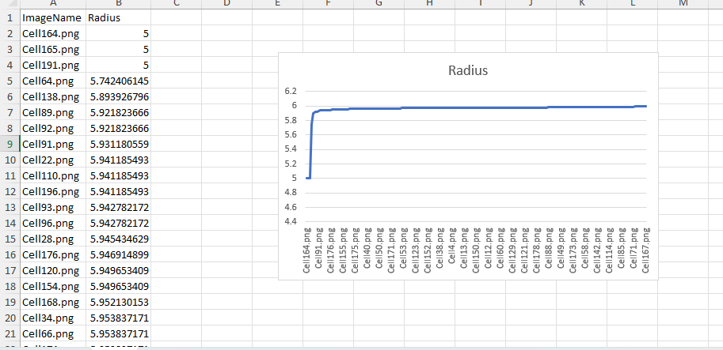
Cell Radii - Limited Size Range
Notes:
Acceptable radius range

Slide 23
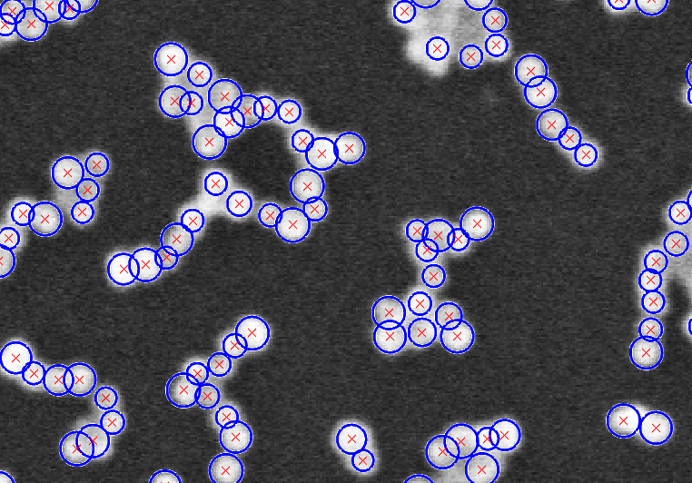
Cell Locations
Notes:
This can help in paving the way for other properties as finding the clusters or other properties

Slide 24
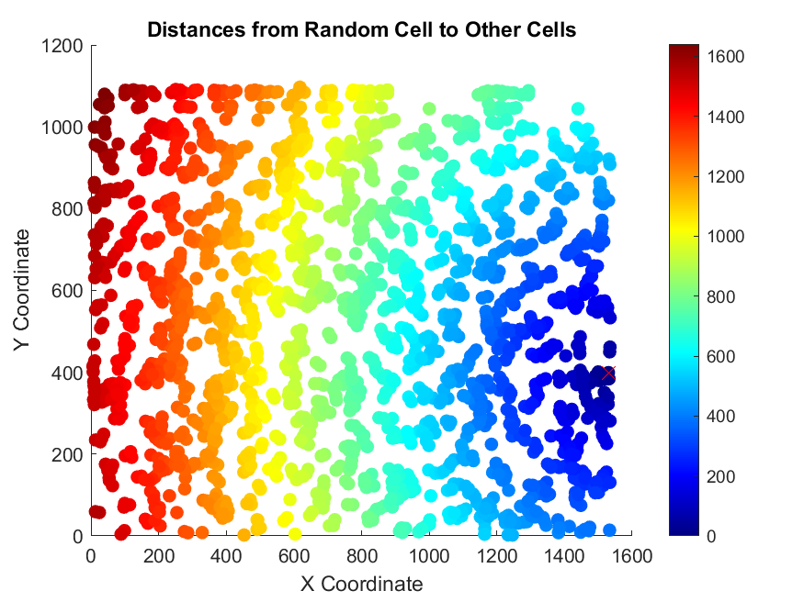
Distance Between Cells

Slide 25
Thank You
Any Questions?

